Slide 2
College costs are at an all-time high
$44,820
$18,390
$11,970
Data from the College Board
Notes:
These are the amounts students are likely to pay for college this year. Tuition has been increasing exponentially for decades, far outpacing inflation. Over the past 35 years, college tuition at public universities has nearly quadrupled. Costs are likely to continue going up.
https://trends.collegeboard.org/college-pricing/figures-tables/average-published-undergraduate-charges-sector-2017-18

Slide 3
College Savings Plans are the Antidote to Student Loan Debt
Mark Kantrowitz, Forbes (August 31, 2018)
“Student loan debt has reached a shocking milestone, with more than 44 million Americans owing more than $1.5 trillion in federal and private student loan debt. That’s more than double a decade ago.”
“There’s a simple solution that parents can take to reduce reliance on student loan debt, and that’s to save more. Every dollar saved is a dollar less borrowed.”
Notes:
Here is the link to the article: https://www.forbes.com/sites/markkantrowitz/2018/08/31/college-savings-plans-are-the-antidote-to-student-loan-debt/#3a6989817bf5
About the author: Mark Kantrowitz's mission is to provide practical information, advice and tools to help students and their families make informed decisions about saving and paying for college
I am Publisher and VP of Research for Savingforcollege.com, the most popular guide to saving for college and 529 plans. I am an expert on student financial aid, the FAFSA, scholarships and student loans. I have been quoted in more than 10,000 newspaper and magazine articles .

Slide 4
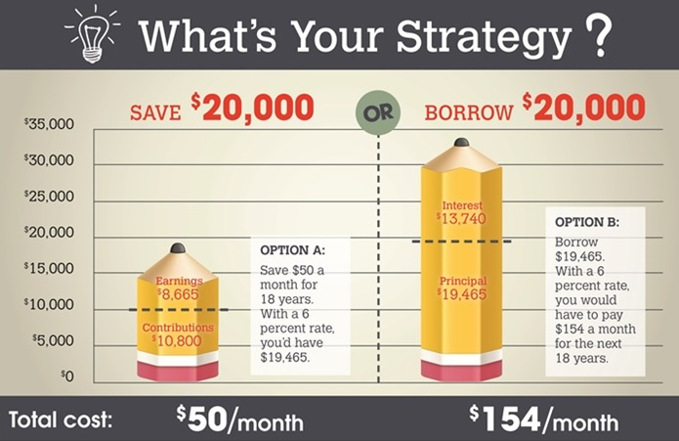
It’s cheaper to save than to borrow
Data from FinAid.com

Slide 5
Tools to pay for higher education
Financial Aid
  Scholarships
  Grants
  Student Loans
    Learn more at:
      FinAid.org
      OregonStudentAid.gov
Saving Opportunities
  Oregon College Savings Plan

Slide 6
Oregon College Savings Plan
Oregon College Savings Plan accounts allow people to invest their savings tax-free
Open to US citizens or resident aliens
Can contribute up to $400,000 per student
Accounts can be opened for as little as $25
Can be used at universities, community colleges or vocational schools
Covers tuition, fees, room and board, computers and other education expenses

Slide 7
Tax advantages and fees
State Tax Deduction
  Oregon state income tax deduction up to $4,750 for joint filers and $2,375 for single filers, adjusted annually
  Friends and family who open an account are also eligible for the state tax deduction
Tax-free Growth
  After-tax program
  As the money you deposited gets invested and grows, the earnings are not taxed
Fees
  No application or transfer fees
  No commissions paid on accounts
  Total fees between 0.25% to 0.72%

Slide 8



How does it work?
Account Beneficiary
Account Owner
Graduate!!!
Parents
Grandparents
Family
Friends
Child
Grandchild
Yourself
Anyone

Slide 9
Investment and savings options
15 Investment Options
  College Enrollment Year Portfolios
  Static Portfolios including:
    Target Risk
    Diversified Equity
    Social Choice Balanced
    Fixed Income Index
    FDIC-Insured Option
Unsure which option is best for you? We have some helpful tools like a College Savings Calculator and a Risk Tolerance Quiz on our website at www.OregonCollegeSavings.com/resources/.

Slide 10
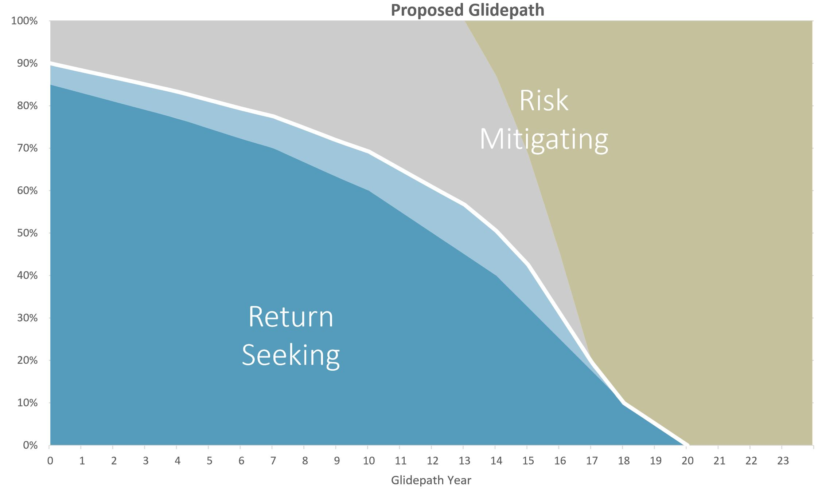
College Enrollment Year Portfolio
Portfolios automatically transition to more conservative as the student gets closer to college
Options for each college enrollment year provides a smooth transition

Slide 11
Saving has an effect now
Children with a college savings account like the Oregon College Savings Plan have greater college expectations
  Kids who know they have a college savings account (even a small one) are 2.5 times more likely to go and graduate from college
  Low-to moderate-income children with under $500 saved for college are 3 times more likely to go to college and 4.5 times more likely to graduate
Data from Center for Social Development, Washington University in St. Louis

Slide 12


School and community outreach program
Every elementary student receives fun school materials
Every elementary family has the chance to win $100 for a new or existing Oregon College Savings Plan account that participates in the program

Slide 13
Baby Grad
The sooner families start saving for a child’s education, the longer they have to take advantage of the time value of money
Through Baby Grad, parents automatically receive $25 in their Oregon College Savings Plan account when they open it before their baby’s first birthday

Slide 14
Education & Health
Increasing educational attainment positively affects long-term health outcomes
Higher educational attainment increases earnings, which results in the growth of higher-quality goods and services (such as health care) that gradually improves the overall standard of living of an individual
Data from the MacArthur Studies of Successful Aging

Slide 15
K-12
The federal tax reform bill signed into law back in December 2017 expanded 529 programs like the Oregon College Savings Plan to be used for private K-12 schools.
Specifically withdrawals can be made up to $10,000 a year for private K-12 education tuition.
Withdrawals for K-12 expenses will still receive the federal tax break on their earnings. However, for Oregon tax purposes, the state tax deduction and tax free growth do not apply to withdrawals for K-12 expenses.
Meaning if you take a K-12 withdrawal, the tax deductions you received on this amount will be calculated in what you owe the state for the current tax year.
Also, any earnings tied to the K-12 withdrawal will count as state taxable income.

Slide 16

For too long, people with disabilities could not save for the future out of fear of losing needed government benefits. The Oregon ABLE Savings Plan allows people with disabilities to save for the future without losing their vital benefits.
Tax-advantaged savings account for people with disabilities and their families
Protects eligibility of state and federal benefits
Uses include education, housing, transportation, health care, etc.
State tax deduction for accounts with beneficiaries under 21
Strong wraparound services

Slide 17
Contact Us
John Valley
Outreach Director
john.valley@ost.state.or.us
Oregon Savings Network
503-373-1903
Oregon College Savings Plan OregonCollegeSavings.com
866-772-8464

Slide 18
Thank You

