Slide 1

Volunteer Orientation

Slide 2

Volunteer Basics
ParentSquare vs. Raptor
  Raptor is our public safety/security and volunteer registration software
  ParentSquare is used to share volunteer opportunities and allow volunteers to sign-up for shifts
Anyone can be a volunteer!
  Parents, grandparents, community members are allowed to volunteer provided they are submitted a Raptor application and been accepted into the volunteer system. See info on following slide to share with prospective non-parent community volunteers.

Slide 3
Non-Parent Community Volunteers
Do you know someone who would love to get involved or be "in the know" about volunteer opportunities at the school? We love our volunteers, whether parents, grandparents, guardians, aunts, uncles, friends, you name it! Here's how they can get started:
  Step 1: Submit your volunteer application in Raptor, same as the process for parents
  Step 2: Once your background check is approved, create a Community Volunteer ParentSquare Account. This will connect you to Fir Grove and all the opportunities for volunteering and volunteer sign ups. Volunteer sign ups are now on ParentSquare, NOT on Raptor.
Have questions about navigating the nuances of the systems? Just shoot us an email at Volunteer@FirGrovePTO.com! No question is too small, we are so very grateful for anyone that can lend a hand!

Slide 4

Confidentiality and Professionalism
Sight and Sound Policy
  Volunteers should not be alone with students; any time you’re working with a student you should be within sight and sound of a staff member.
Privacy and Confidentiality
  Treat interactions you witness or overhear in the classroom as private – i.e. don’t gossip about students and staff.
Behavior Management
  Volunteers are at the school to help, but class/behavior management is the teacher's responsibility. If you have a concern about behavior, please go to the teacher rather than addressing it yourself.
Dependability
  If you have signed up for a shift, please show up ☺
  Things happen, so if you’re unable to make it please give as much notice as possible so that we can try to fill your spot.

Slide 5
Arrival Procedures
Arrive 5-10 minutes early if possible
Bring ID to sign-in via Raptor
Raptor will:
  Scan your ID
  Take your photo
  Print you a volunteer badge
Volunteers are automatically logged out at the end of day if you forget to check-out

Slide 6
Why sign-in?
Need to know who is in the building and where/why
Emergencies
Volunteer statistics
  School board – as an indicator of parent involvement
  New parents and prospective teachers – to know how much support the school has
  Grant applications often require volunteer involvement data

Slide 7
Logging Hours
You can track your own volunteer hours in ParentSquare
  Upper right click on your name, then “My Account”
  “Volunteer Hours” if final option on bottom left

Slide 8
Restrooms
Adults/volunteers are not to use the student bathrooms
  Adult restrooms are available in three locations (see map on following slide)

Slide 9
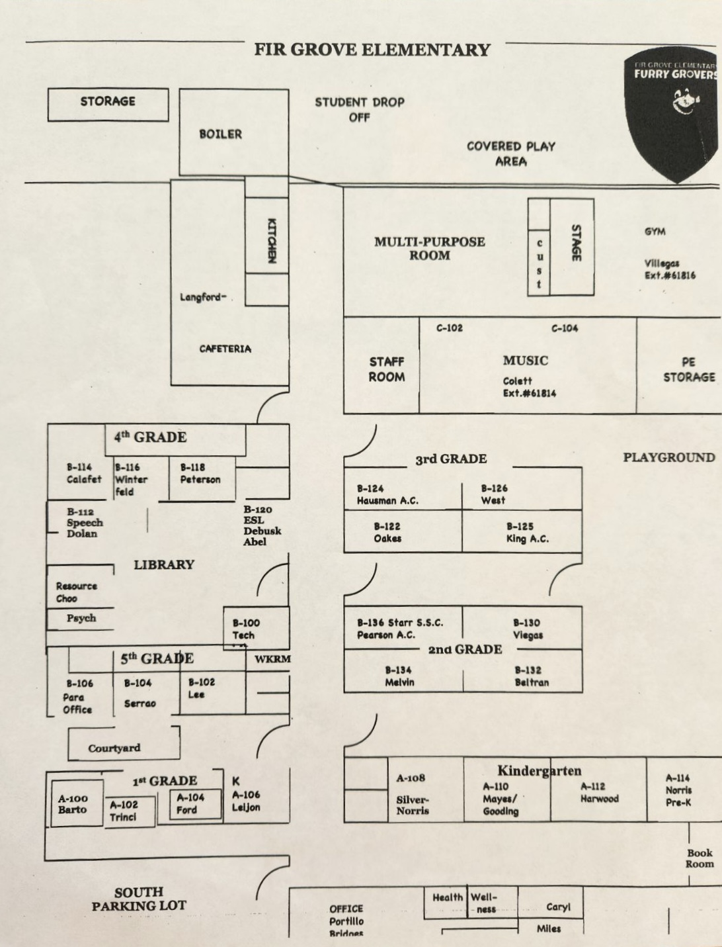
Single all gender restroom inside kitchen
Men's and Women's adult restrooms
Single all gender restroom across from Ms. Miles office

Slide 10
Non-Student Children
Do not bring children with you to volunteer
  This is a district requirement
  Volunteers should not bring younger siblings or babies to school when they are scheduled to volunteer. It is a safety issue. It is distracting in the classroom and other areas and causes a disruption when there are additional children in a classroom or other learning space. (This is direct language from AR: KAA)

Slide 11
Questions?
Do not hesitate to email volunteer@firgrovepto.com with any questions that arise – we are here to help you help Fir Grove!

